Slide 1
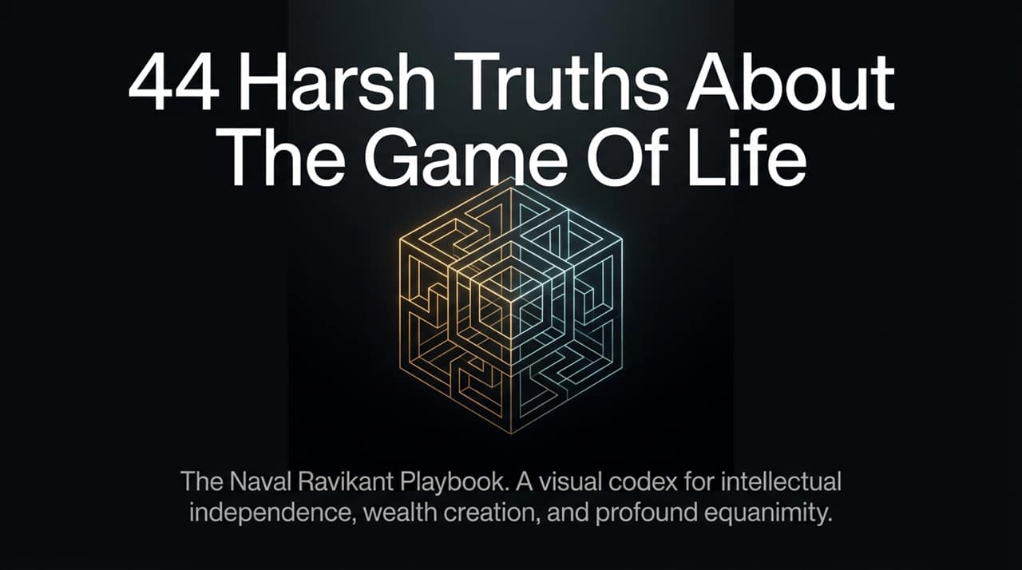
Notes:
https://www.youtube.com/watch?v=KyfUysrNaco
Welcome everyone. Today we are covering the core principles of Naval Ravikant's playbook on life, wealth, and inner peace.
Naval famously notes that many of these insights started as "notes to himself"—contextual realizations that evolved over time.
The overarching goal of this framework isn't just to accumulate riches or status; it's to play the game of life, win it, and ultimately become completely free from it. Let's dive in.

Slide 2
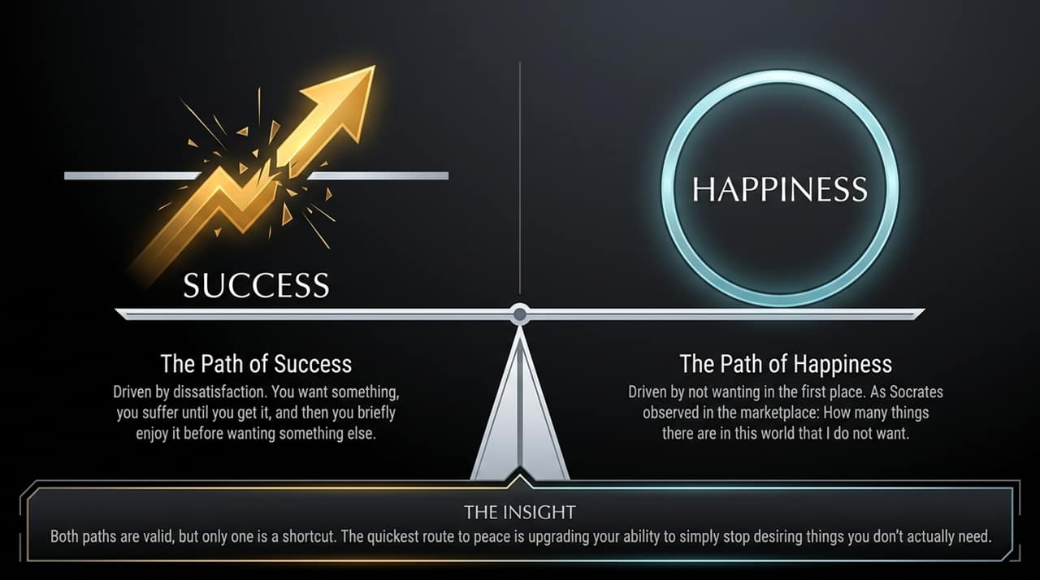
Notes:
The Path of Success is driven by dissatisfaction. You want something, you suffer until you get it, enjoy it briefly, and then want the next thing.
The Path of Happiness is driven by non-wanting. As Socrates observed in the marketplace: "How many things there are in this world that I do not want."
The Naval Context: Naval mentions that while renouncing all material desires like Diogenes sitting in a barrel sounds noble, for most of us, it’s far easier to achieve our material desires first than to pretend to renounce them. Buddha started as a prince before he went into the woods.
The ultimate shortcut to equanimity is upgrading your ability to simply stop desiring things you don't actually need.

Slide 3
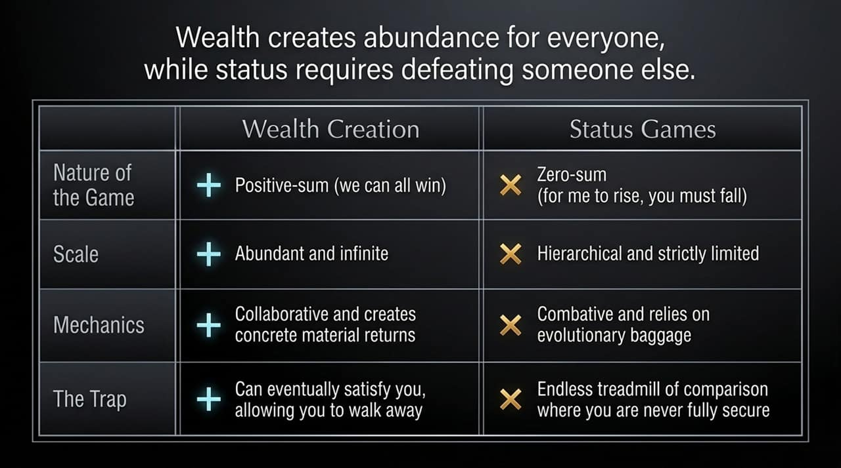
Notes:
To navigate life effectively, you must understand the distinction between Wealth Creation and Status Games.
Wealth creation is positive-sum. It creates abundance for everyone without needing to tear anyone else down. When you invent or build something useful, the total pie grows.
Status games are zero-sum and hierarchical. For you to rise, someone else must fall. They are rooted in evolutionary baggage, creating an endless treadmill of social comparison.
As Naval points out, you can’t cash status at the bank. Play wealth games to buy back your time and freedom, and avoid the combative trap of status games.

Slide 4
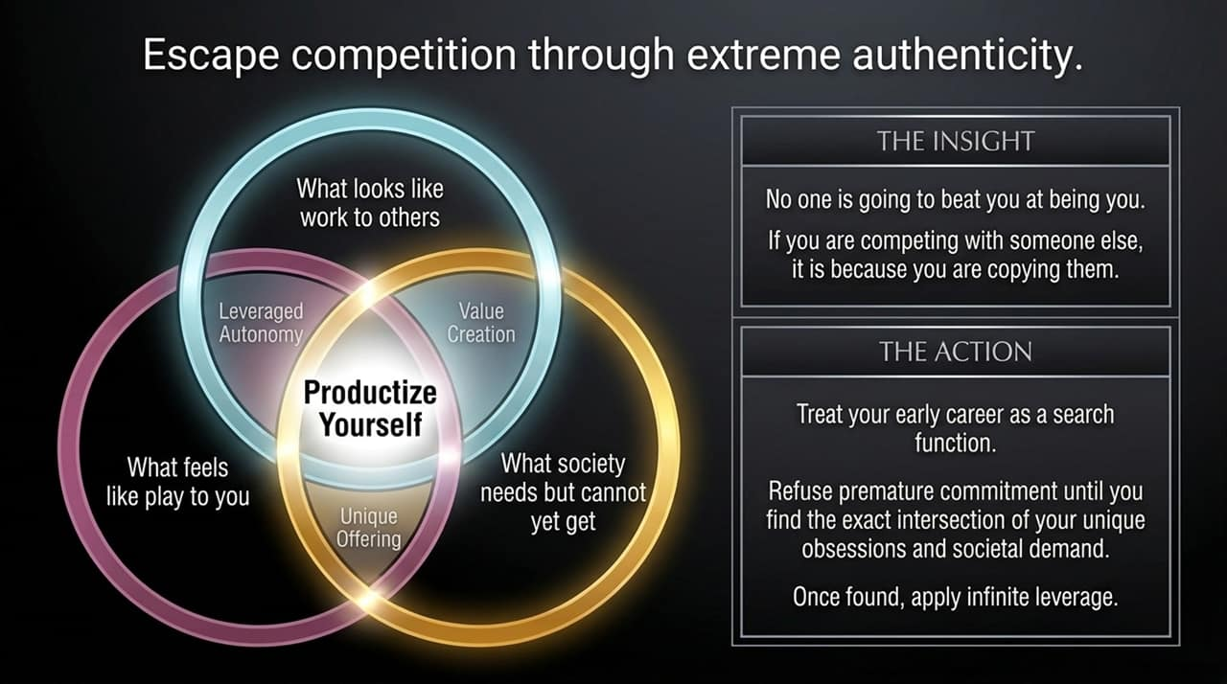
Notes:
Naval’s central advice for career and wealth is simple: Productize Yourself.
Look at the intersection of three circles:
What feels like play to you
What looks like work to others
What society needs but cannot yet get
The Insight: No one can beat you at being you. If you are competing with someone, it’s because you are copying them.
Actionable takeaway: Use your early career as a search function. Refuse premature commitments until you discover your unique obsessions, then apply infinite leverage to scale it.

Slide 5
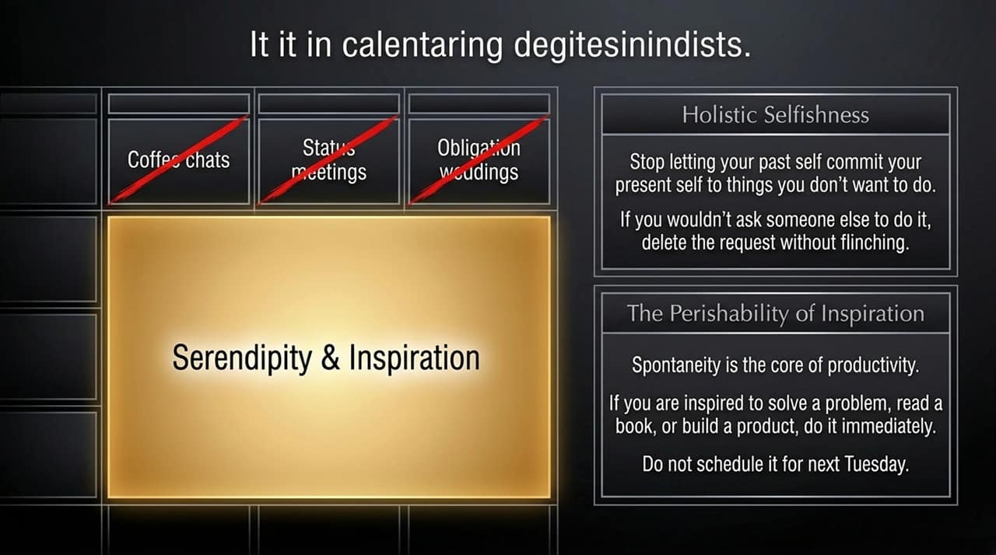
Notes:
Holistic Selfishness: Stop letting your past self commit your present self to things you don't actually want to do. Cancel obligatory meetings, coffee chats, or events you wouldn't ask someone else to attend.
Perishability of Inspiration: Spontaneity is the core engine of productivity. Inspiration is a perishable commodity.
If you feel an impulse to solve a problem, read a book, or write code, do it now—don't schedule it for next Tuesday, because by then, the magic is gone.

Slide 6
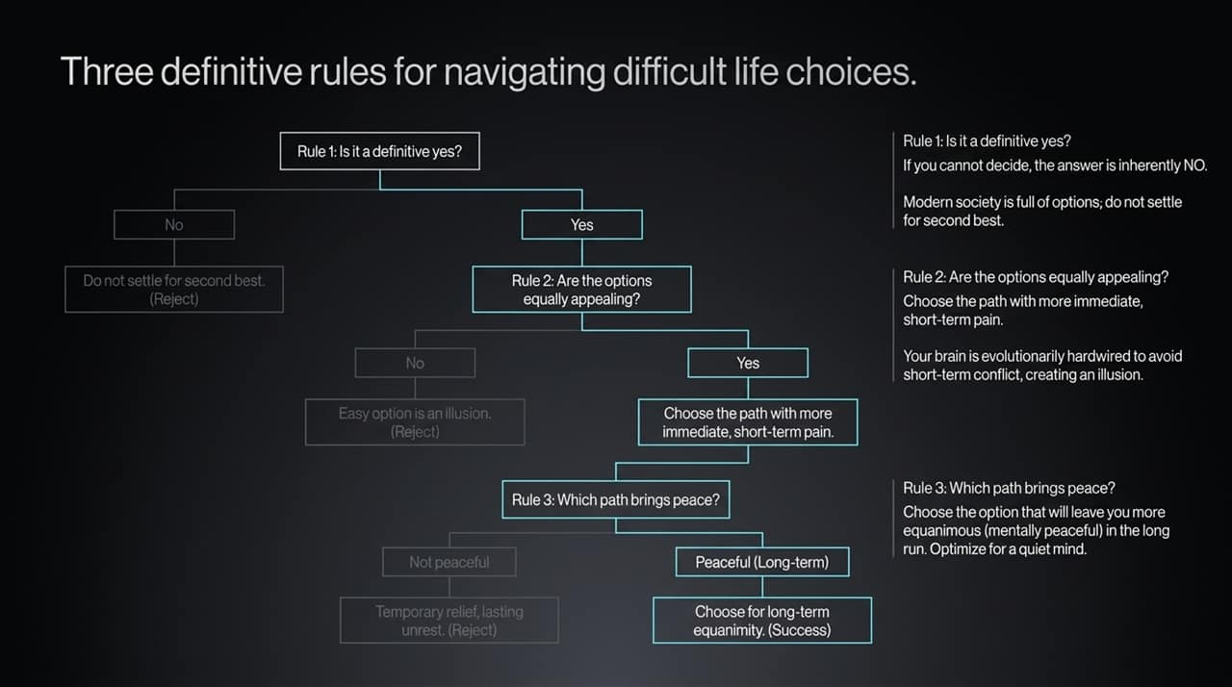
Notes:
When faced with difficult life decisions, follow these three rules:
Rule 1: Is it a definitive yes? If you cannot decide, the answer is an automatic NO. Don't settle for second best in a world overflowing with options.
Rule 2: Are the options equally appealing? If two options are equally attractive, pick the path with more immediate, short-term pain. Your brain is evolutionarily wired to avoid short-term discomfort, masking the better long-term choice.
Rule 3: Which path brings peace? Choose the option that leaves you mentally peaceful and equanimous in the long run. Optimize for a quiet mind.

Slide 7
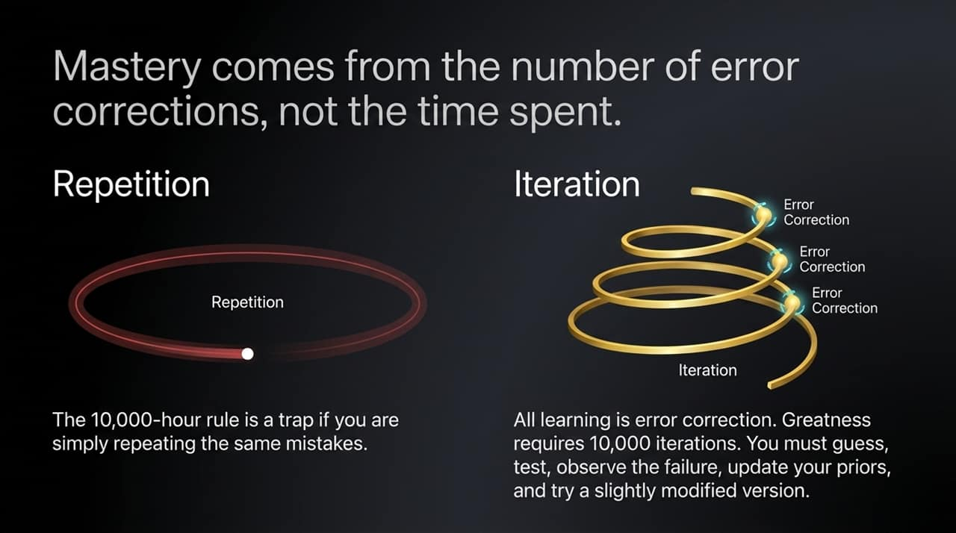
Notes:
The famous "10,000-hour rule" is a trap if you are simply repeating the exact same mistakes 10,000 times.
Mastery comes from the speed and number of error corrections, not the clock time spent.
True learning requires 10,000 iterations: guess, test, observe the failure, update your priors, and execute a slightly modified version.

Slide 8
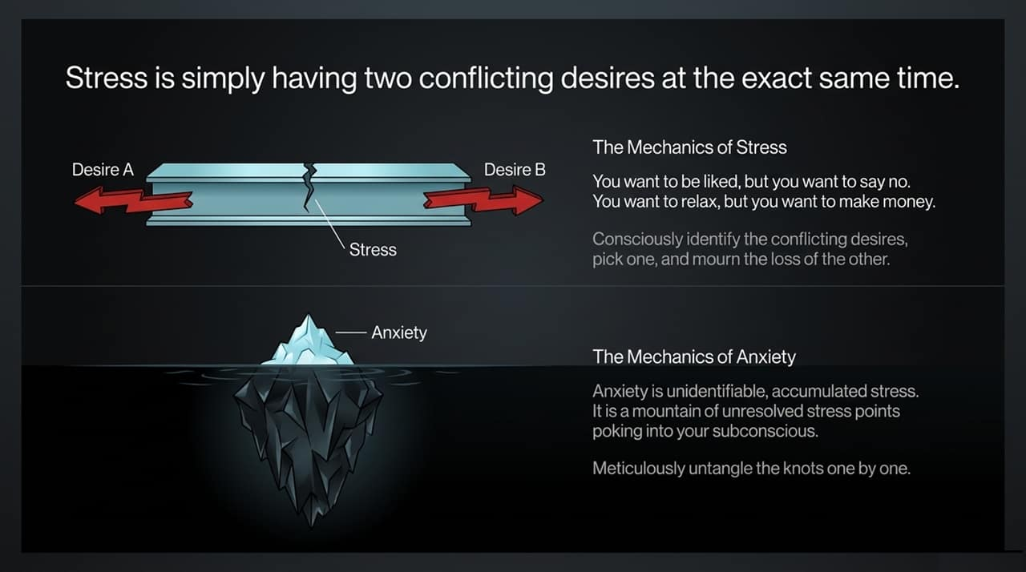
Notes:
The Mechanics of Stress: Stress is not external circumstances; it is simply holding two conflicting desires at the exact same time. (e.g., wanting to say no vs. wanting to be liked; wanting to relax vs. wanting to make money).
Solution: Consciously identify the conflict, pick one path, and actively mourn the loss of the other.
The Mechanics of Anxiety: Anxiety is unidentifiable, accumulated stress—a mountain of unresolved conflicts poking into your subconscious. Untangle these knots one by one through conscious reflection.

Slide 9
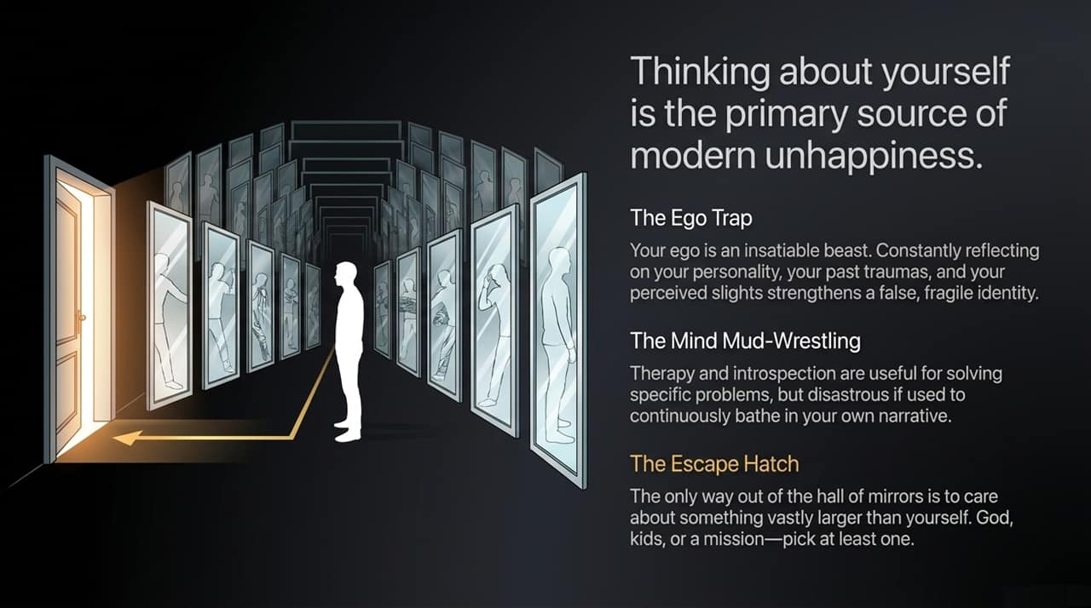
Notes:
Thinking about yourself is the single greatest source of modern unhappiness.
Constantly dwelling on your personality, past traumas, or slights feeds an insatiable ego.
Therapy and introspection have utility for specific problems, but continuously bathing in your own personal narrative becomes "mind mud-wrestling."
The Escape Hatch: To break out of this mirror hall, focus on something vastly larger than yourself—whether that is family, kids, a higher power, or a grand mission.

Slide 10
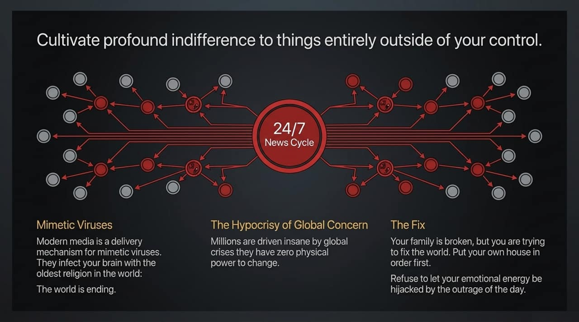
Notes:
Modern media is an delivery system for "mimetic viruses" that hijack your emotional energy with catastrophic narratives.
Millions of people drive themselves insane over global crises they have zero physical agency to fix, while ignoring immediate issues in their own lives.
The Fix: Put your own house in order first. Cultivate profound indifference to matters outside your direct control, and preserve your mental energy for what you can actually change.

Slide 11
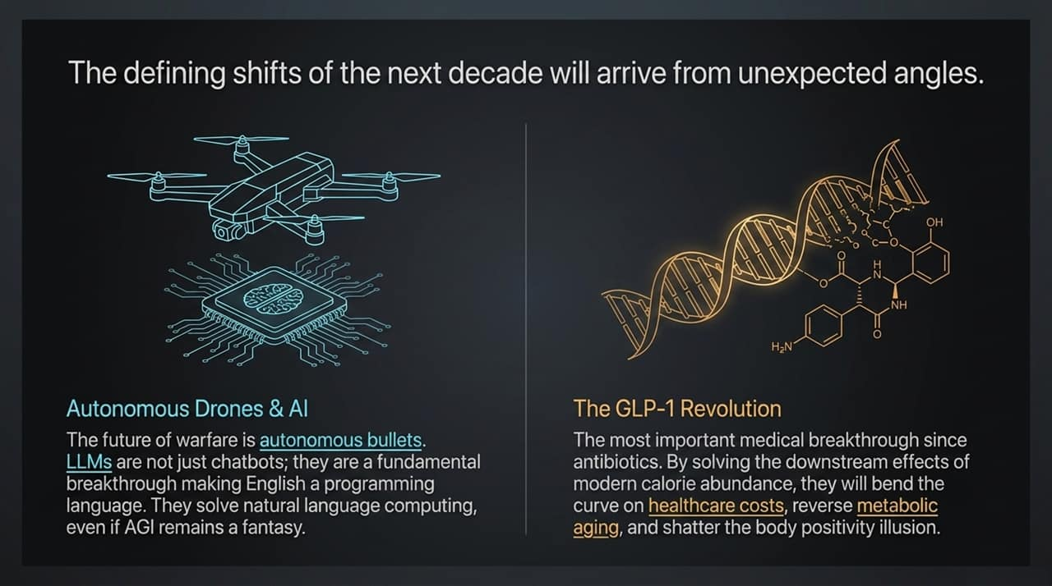
Notes:
Groundbreaking shifts always arrive from unexpected angles:
AI & LLMs: LLMs aren't just chatbots; they turn English into a programming language, solving natural language computing.
Autonomous Drones: Autonomous software is redefining the future of defense.
GLP-1 Revolution: Naval regards GLP-1 medications as one of the most significant medical breakthroughs since antibiotics. By addressing the downstream effects of calorie abundance, GLP-1s will bend healthcare costs and transform metabolic health.

Slide 12
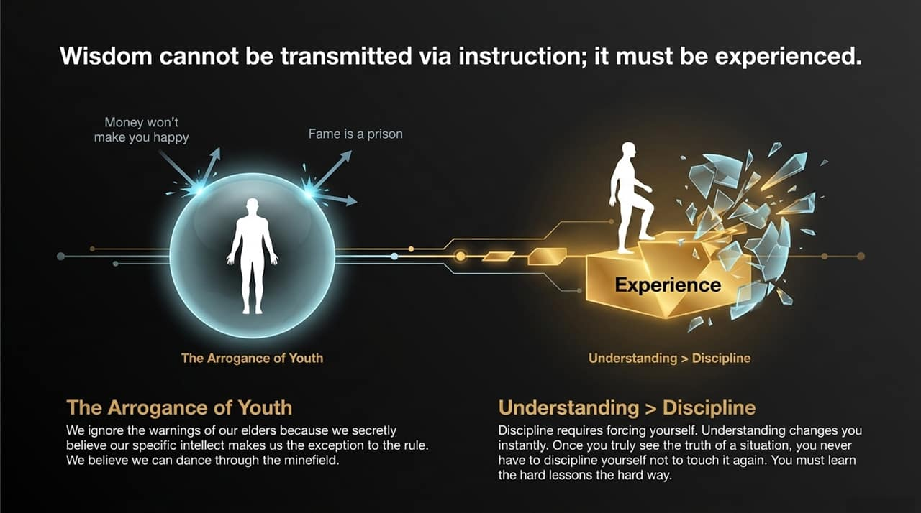
Notes:
Arrogance of Youth: Young people often ignore elders' warnings believing their unique intellect makes them an exception to universal truths.
Understanding vs. Discipline: Discipline is forcing yourself to do something you dislike. Real understanding changes you instantly. Once you truly understand a danger, you don't need willpower to avoid it.
Naval’s Reflection: Naval notes that if he went back in time, he would do almost everything the same, but with less anger, emotion, and internal suffering—because that suffering was completely optional.

Slide 13
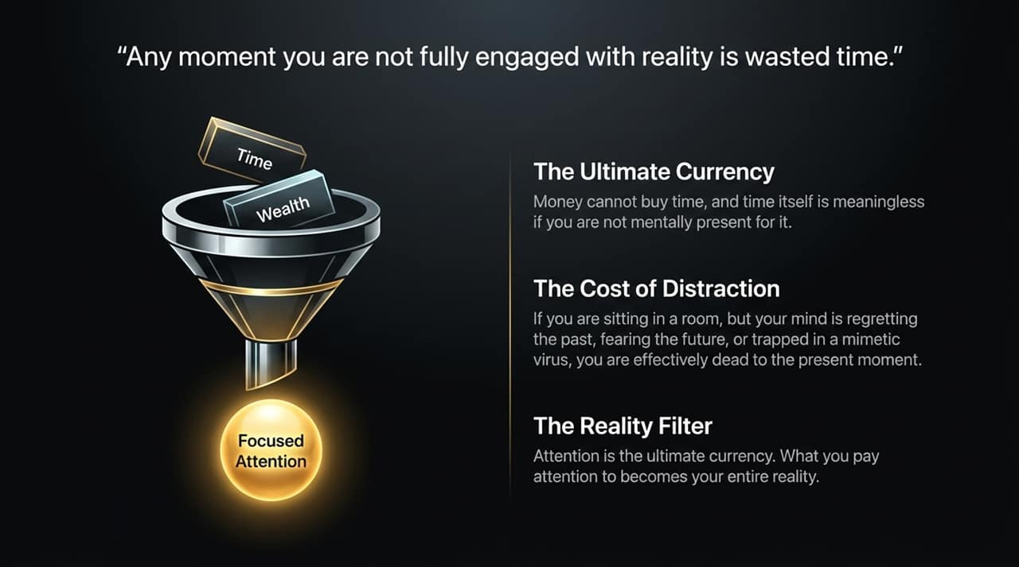
Notes:
"Any moment you are not fully engaged with reality is wasted time."
Money cannot buy time, and time is useless if you aren't mentally present for it.
If your mind is trapped regretting the past or anxious about the future, you are functionally absent from life. What you pay attention to becomes your reality.

Slide 14
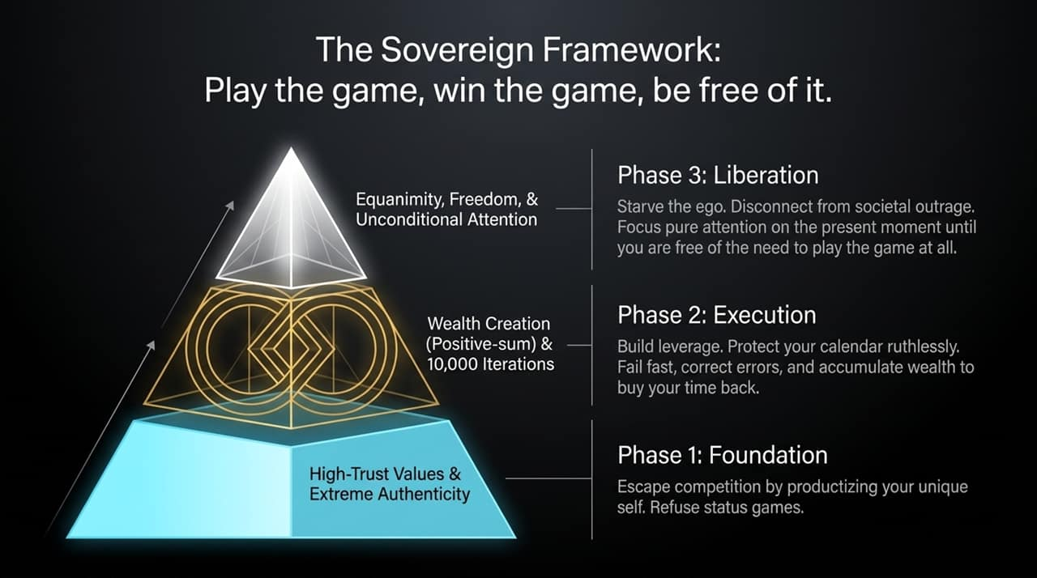
Notes:
Phase 1 (Foundation): Escape competition by productizing your unique self. Avoid zero-sum status games.
Phase 2 (Execution): Protect your time, iterate quickly through 10,000 error-corrections, build leverage, and accumulate wealth to buy your time back.
Phase 3 (Liberation): Disconnect from societal outrage, starve the ego, and cultivate unconditional presence. The ultimate reason to win the game is so you can stop playing.

Slide 15
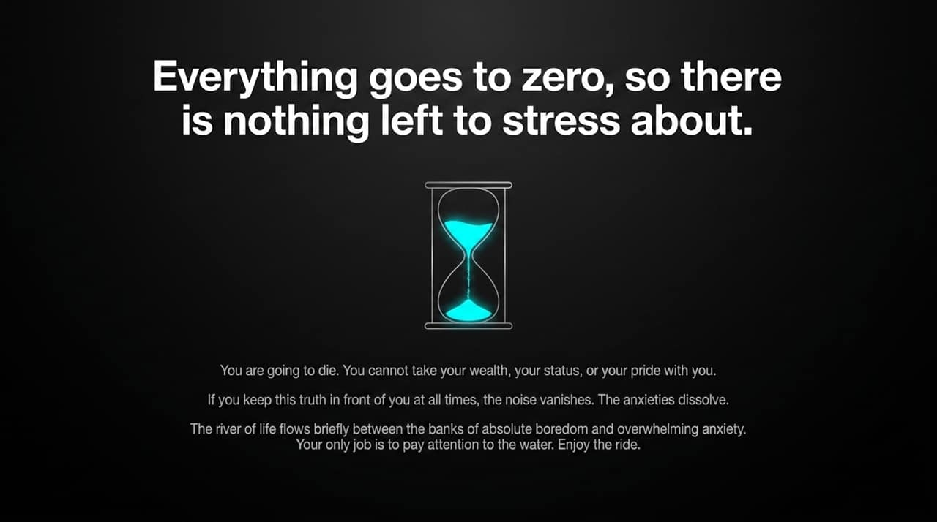
Notes:
Keep the truth of mortality front and center: you are going to die, and you can't take your wealth, status, or pride with you.
When you hold death in mind, superficial anxieties and outrage vanish.
Life flows briefly between absolute boredom and overwhelming anxiety. Your job is simply to pay attention to the water and enjoy the ride.

Slide 16
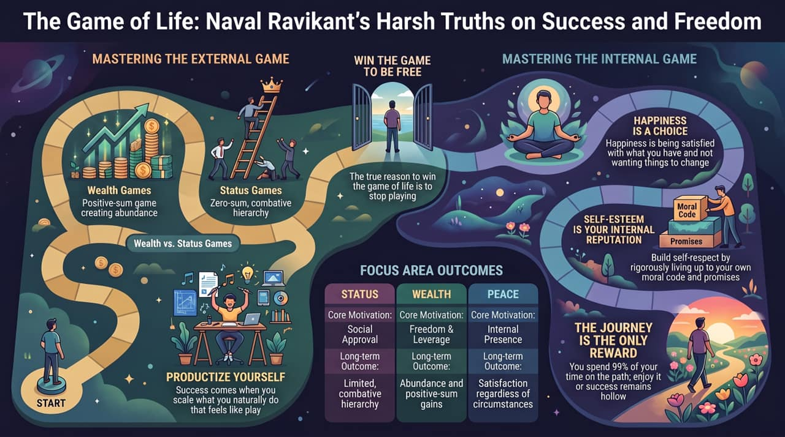
Notes:
Mastering the External Game: Win wealth games (positive-sum abundance) to buy freedom, while rejecting status games (zero-sum hierarchies).
Mastering the Internal Game:
Self-Esteem: Build internal reputation by adhering to your own moral code and keeping promises to yourself.
Happiness: Realize happiness is a choice—being satisfied with what you have without demanding reality to change.
Remember: You spend 99% of your time on the path. The journey isn't just the reward; it's the only thing that exists.

